Slide 1
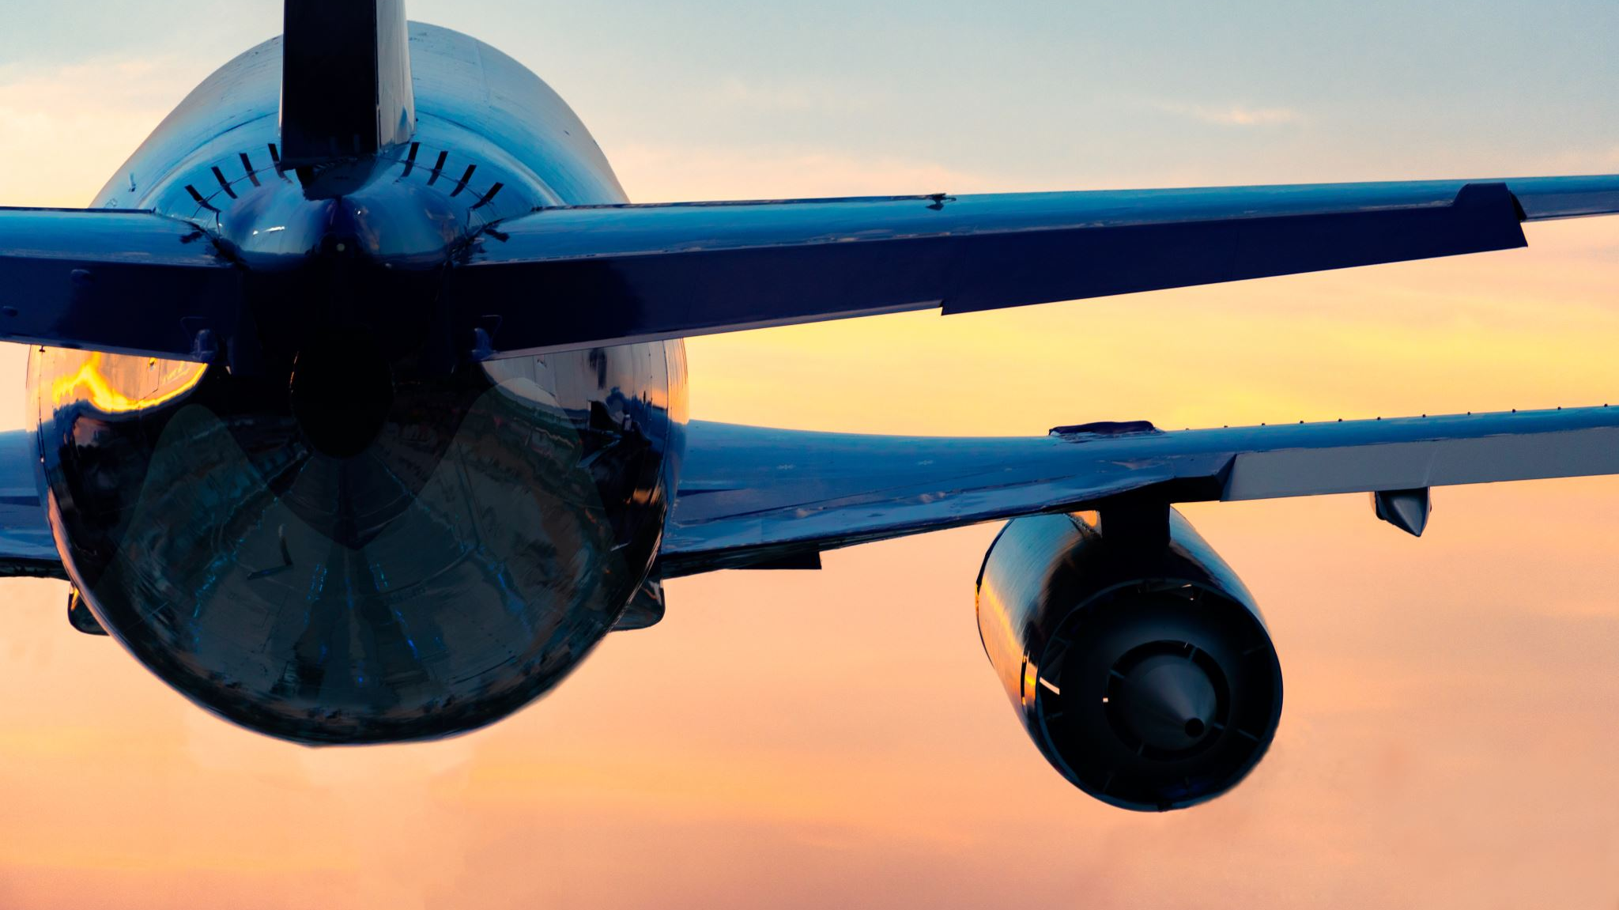
Airline Passenger Satisfaction
Presenter: Ishan Kuchroo
Date: 3rd May 2022

